Slide 1


Nonlinear Macroeconomic Effects in CRE Vacancy Forecast Models
Michael Taylor | ARES April 2019

Slide 2
Introduction
Can we better incorporate business cycles into vacancy forecast models?
Overview of CoStar’s metro forecast models
Potential nonlinear transformations of macroeconomic variables
Results of vacancy forecast models with additional variables

Slide 3
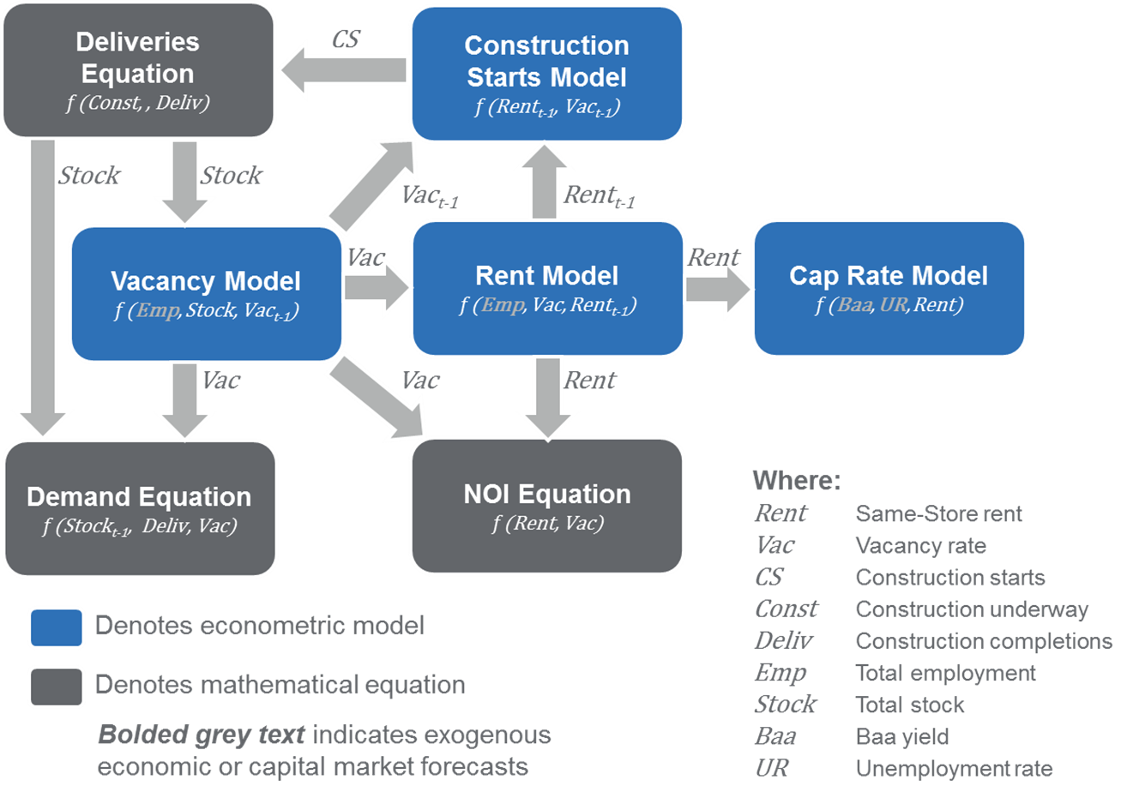
CoStar Metro Forecast Model

Slide 4
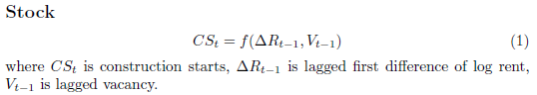
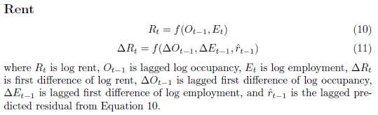
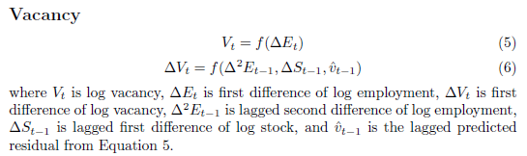
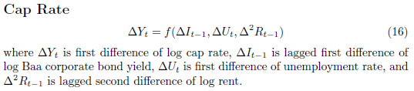
Regression Equations

Slide 5
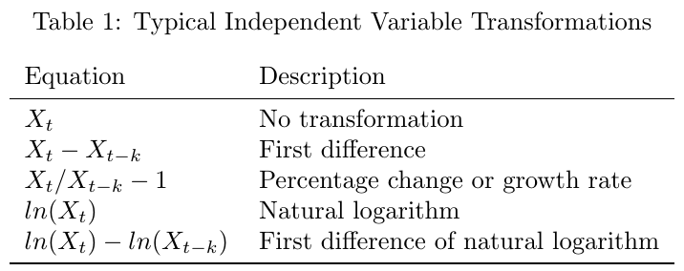
Linear Transformations

Slide 6
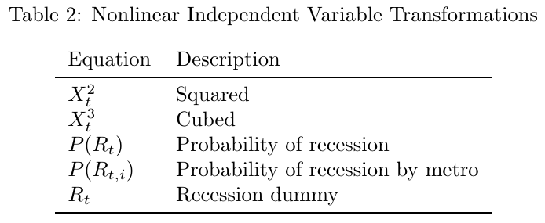
Additional Nonlinear Transformations

Slide 7
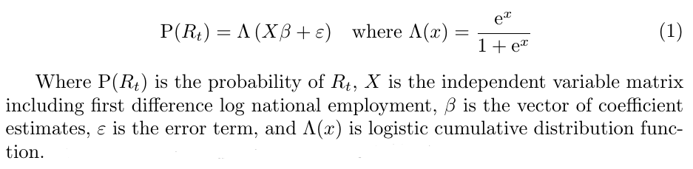
Probability of Recession Binary Logistic Regression

Slide 8
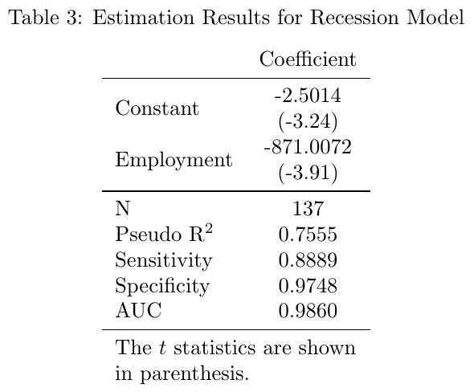
Recession Model Estimation Results

Slide 9
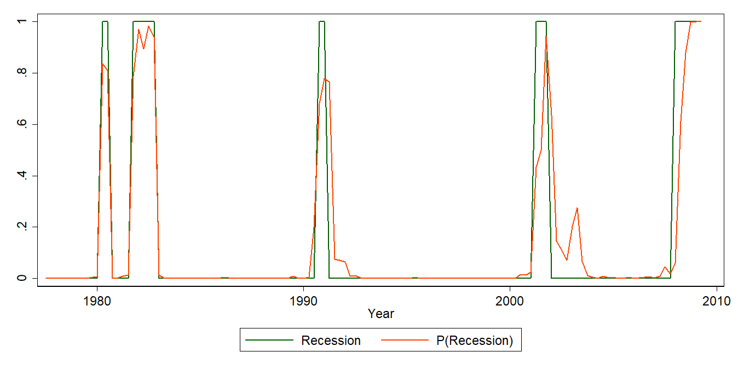
Recession Model Fitted Values

Slide 10
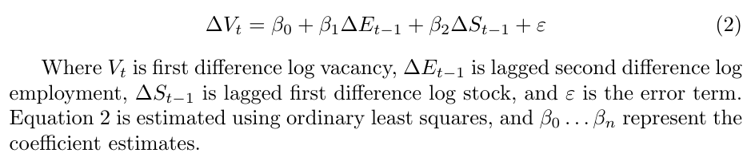
Baseline Vacancy Forecast Model

Slide 11
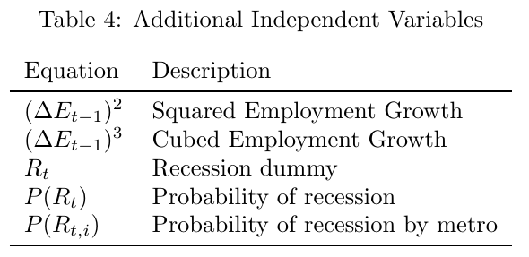
Additional Independent Variables

Slide 12
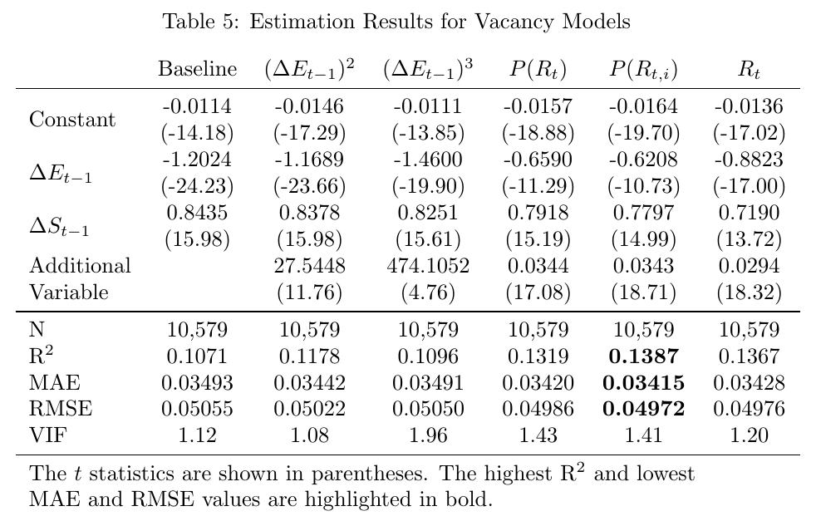
Vacancy Forecast Model Estimation Results

Slide 13
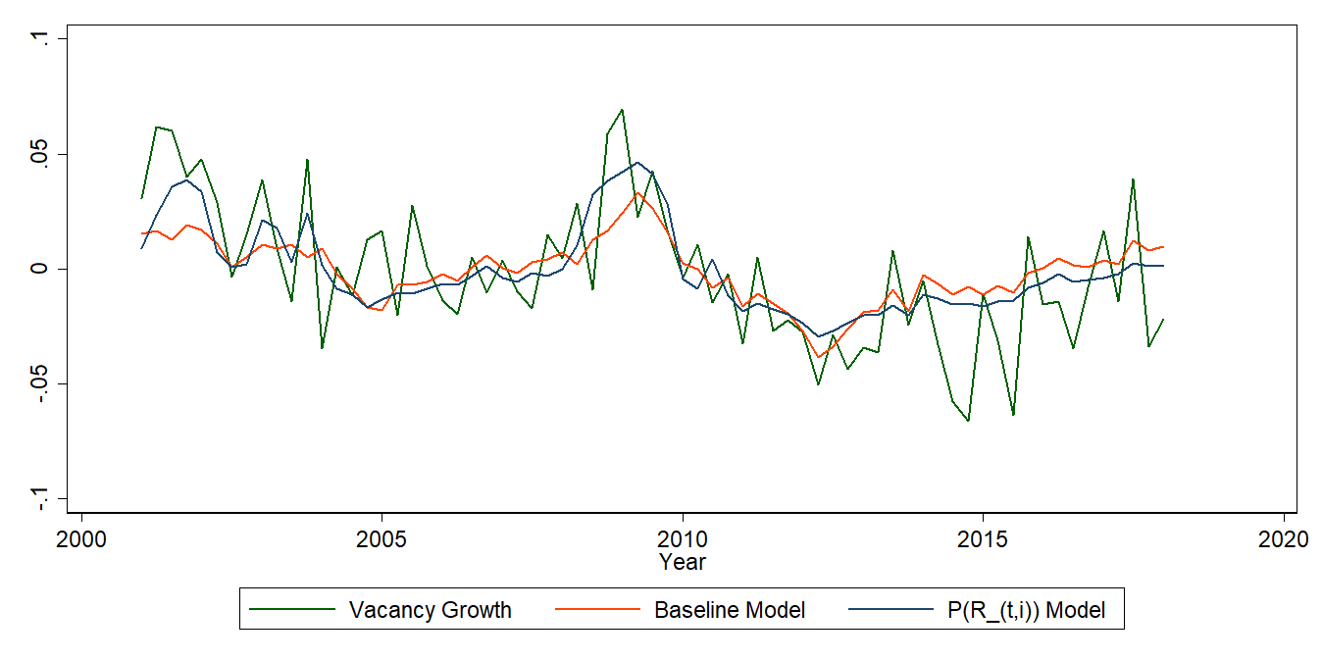
Chicago Industrial In-Sample Fitted Values

Slide 14
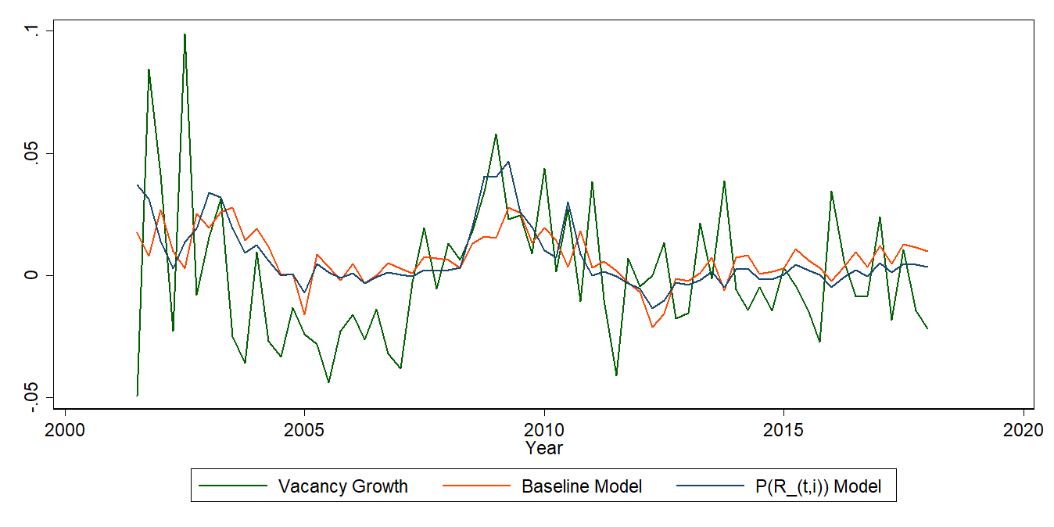
New York Office In-Sample Fitted Values

Slide 15
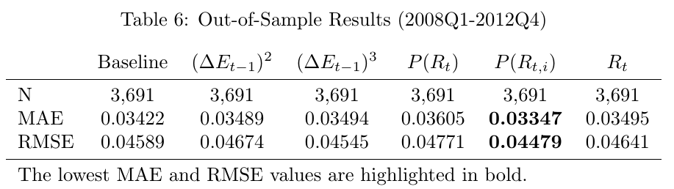
Out-of-Sample Results (2008Q1-2012Q4)

Slide 16
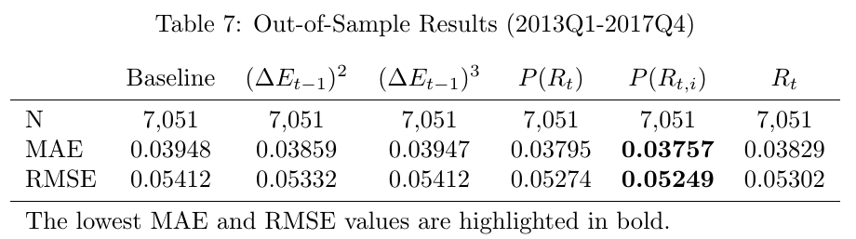
Out-of-Sample Results (2013Q1-2017Q4)

Slide 17
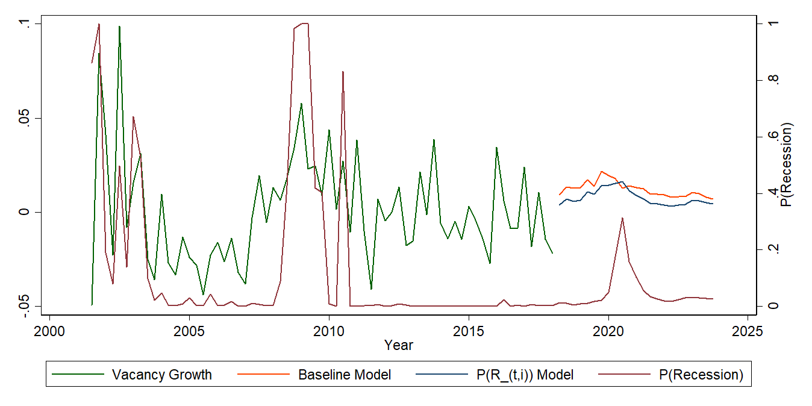
New York Office Base Case Forecast

Slide 18
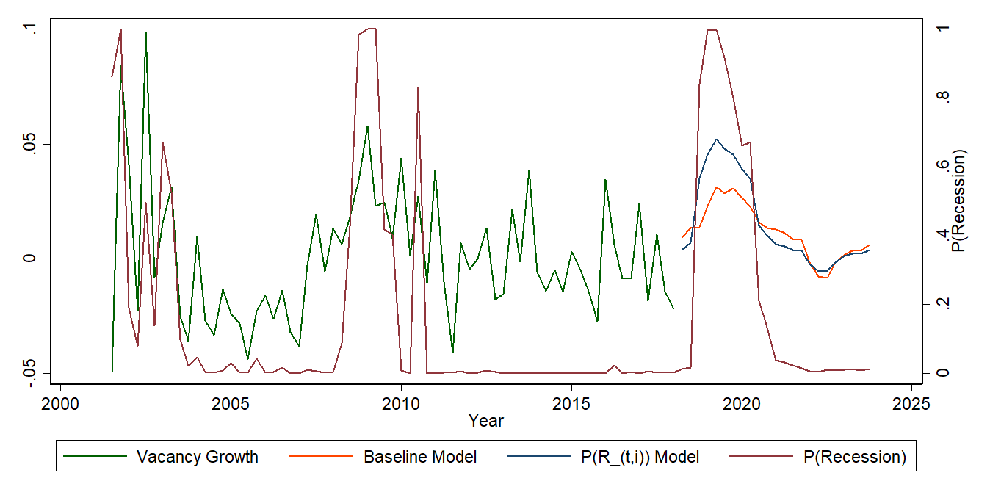
New York Office Recession Forecast

Slide 19
Conclusion
Examined a baseline vacancy forecast model and compared it to five other models with additional variables
Looked at in-sample and out-of-sample results
The addition of nonlinearly transformed variables improved the fit of the baseline vacancy model
In particular, the addition of the fitted values from a recession model using metro employment as its independent variable
Even though employment was already a factor
Underscores that the real world is complex and nonlinear
Demonstrates a practical method to factor business cycles into vacancy forecast models

Slide 20
Future Research
Add nonlinear macroeconomic effects to other CRE forecast models
Additional nonlinear transformations of the employment variable, or of other variables
Separate property type or metro models

Slide 21
Questions or Comments?

Slide 22

© Copyright 2018 CoStar Group, Inc. All Rights Reserved. Although CoStar makes efforts to ensure the accuracy and reliability of the information contained herein, the following information includes projections that are based on various assumptions by CoStar concerning future events and circumstances, as well as historical and current data maintained in CoStar’s database. Actual results may vary from the projections presented. The information in this presentation is provided ‘as is’ and CoStar expressly disclaims any guarantees, representations or warranties of any kind, including those of merchantability and fitness for a particular purpose. Features shown in this presentation may require additional subscriptions.

